Slide 1
Balanced Diet
Important points

Slide 2
Definition
A diet that contains adequate amounts of all the necessary nutrients required for healthy growth and activity.
All essential nutrients
In adequate amount
Necessary for healthy growth and normal functioning

Slide 3
Elements of balanced diet
Carbohydrates
Proteins
Fats
Vitamins
Minerals
water

Slide 4
Carbohydrates
Complex organic compounds consisting of C, H, O
Energy yield; 4 K calories/ gram
Provide 60 to 80 % of total calories
Four groups:
monosaccharides, disaccharides,
oligosaccharides, and polysaccharides
Functions:
Storage of energy; glycogen
Structural components; cellulose, DNA, RNA
Fuel for metabolism; glucose
Sources:
Grains, potatoes, sugarcane, honey etc

Slide 5
Lipids
Naturally occurring molecules include fats, oils, fat soluble vitamins
Major source of energy in balanced diet
Energy yield; 9 kcal/gram
Functions:
Energy storage
Structural components; cell membrane
Hormones; testosterone, cortisol
Sources:
Animal source; butter, fish oil
Plant source; corn oil, sunflower oil

Slide 6
Proteins
Biological compounds/macromolecules/ nitrogenous substances composed of chains of amino acids linked through peptide bond.
Essential component of balance diet
Energy yield; 4 kcal/gm
Functions:
Important structural component; muscle, protoplasm
Enzymes; pepsin
Hormones; insulin
Transport; hemoglobin
Blood clotting; fibrinogen
Immunity; antibodies
Sources;
Meat, egg, milk, beans, peas

Slide 7
Amino acids
Building blocks of proteins
Total 20 amino acids
Composed of H, C, N, O
Types:
Essential
Can not be produced by human body
Must need take in diet
Histidine, leucine, isoleucine, lysine, methionine, valine, phenylanaline, tryptophan, theonine
Non-essential
Synthesized within human body
Alanine, arginine, cystein, glycine, proline, serine, tyrosine

Slide 8
Vitamins
Organic substances which do not provide energy but are essential for normal functioning of body
Total daily requirement very small
Can be stored in body
Important role in cell growth and repair
May be water soluble or fat soluble
Their deficiency causes disease
Their excess may also cause disease

Slide 9
Water soluble vitamins
Can not be stored in body, need to get in food daily
Destroyed by over cooking
Easily absorbed by body
Examples:
Vitamin C; ascorbic acid
Vitamin B1; Thiamine
Vitamin B2; Riboflavin

Slide 10
Fat-soluble vitamins
Soluble in fat
Can be stored in body
Do not necessarily daily intake
Excess can lead to disease
Examples:
Vitamins A, D, E, K

Slide 11
Vitamins: source, function, disease
Vitamin A
Source;
Egg, liver, cheese, butter, dark green vegetables
Function;
Growth, body repair
Essential for vision
Important for formation of bone and tissue
Disease;
Night Blindness

Slide 12
Vitamin D
Source;
Egg yolk, milk, liver, sun exposure
Function;
Important for growth
Necessary for development of bones
Disease;
Rickets in Children
Osteomalacia in adults

Slide 13
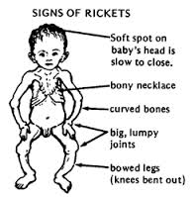

Slide 14
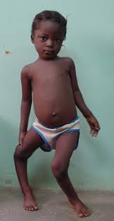

Slide 15
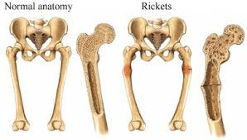

Slide 16
Vitamin E
Source;
Plant oils
Leafy green vegetables
Nuts, seeds
Whole-grain products
Function;
Important role in wound healing
Role in breaking blood clots
Important for prevention of sterility
Role in protein metabolism

Slide 17
Vitamin K
Source;
Leafy green vegetables
milk
Function;
Essential for blood clotting
Disease;
Blood clotting disorders

Slide 18
Vitamin B1; Thiamine
Source;
In all foods in moderate amounts
Bread, cereals, nuts, seeds
Function;
Help in carbohydrate digestion
Essential for bone and joints
Necessary for nerves
Disease;
Beri-Beri

Slide 19
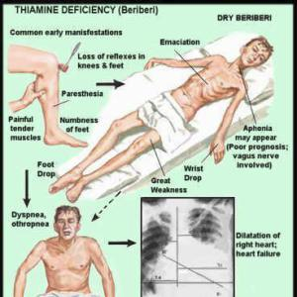

Slide 20
Vitamin B 2; Riboflavin
Source;
Milk and milk products
Breads, cereals
Function;
Protection of skin
Protection of mucous membranes
Disease;
Pellegra

Slide 21
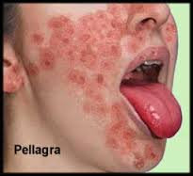

Slide 22
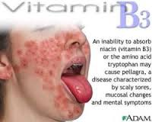

Slide 23
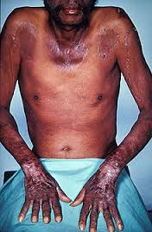

Slide 24
Vitamin B 6; Pyridoxine
Source;
Meat, fish
Vegetables, fruits
Function;
Essential for production of antibodies
Important role in protein metabolism
Necessary for nervous system functioning

Slide 25
Vitamin B 12; Cobalamine
Source;
Meat, fish
Sea food,
Egg, milk
Not found in plants
Function;
Necessary for formation of red blood cells
Disease;
Megaloblastic anemia

Slide 26
Vitamin C; Ascorbic acid
Source;
Citrus fruits
Strawberries, tomatoes, potatoes,
peppers
Function;
Important for healthy teeth and gums
Essential for protection of bones
Disease;
scurvy

Slide 27
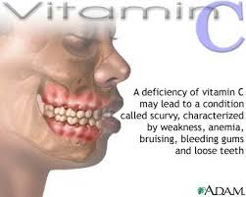

Slide 28
